Slide 1
Major Project – MCA491P
Project Title:
Blockchain-Based File Integrity System
1RV24MC023
C T ULLAS
Under the Guidance
Of
Dr. Divya T.L
Assistant Professor
Department of MCA
R V College of Engineering
Date:23/05/2026 Department of MCA, RVCE

Slide 2
Agenda
Introduction
Implementation
Testing
Results
Conclusion
References
Details of Publication Status

Slide 3
Introduction and Objectives
The project focuses on secure and tamper-proof certificate verification using Blockchain and IPFS.
Traditional certificate systems are vulnerable to forgery and unauthorized modifications.
The proposed system provides decentralized storage and blockchain-based integrity verification.
Approved institutes can issue certificates securely to users.
Verifiers can validate certificate authenticity through blockchain comparison.
The system includes four major modules: Admin, Institute, User, and Verifier.
Technologies used include React.js, Node.js, MongoDB, Solidity, Hardhat, Ethereum Blockchain, and IPFS.

Slide 4
Implementation
Module Name: Admin Module
Purpose: To manage institute approval requests and system control
Input: Institute approval request and verification documents
Process: Approve or reject institute registration requests
Output: Approved/Rejected institute status
Module Name: Institute Module
Purpose: To issue certificates securely to users
Input: User details and certificate files
Process : Raise approval request, issue certificate, upload certificate to IPFS, store CID on blockchain
Output: Verified certificate issuance
Module Name: User Module
Purpose: To manage personal certificates and verifier access requests
Input: Access approval/rejection decisions
Process : View certificates, approve/reject verifier access
Output: Controlled certificate sharing
Module Name: Verifier Module
Purpose: To verify certificate authenticity
Input: Certificate ID and uploaded certificate file
Process : Raise access request, verify uploaded file with blockchain CID
Output: Authentic / Tampered verification result

Slide 5
Testing
Test Case_ID | Feature Tested | Sample Input | Expected Output | Actual Output | Remarks (Pass/Fail)
ADM_01 | Institute Approval | Valid institute request | Institute approved | Institute approved | Pass
ADM_02 | Institute Rejection | Invalid institute request | Institute rejected | Institute rejected | Pass
ADM_03 | Unauthorized Admin Access | Invalid JWT token | Access denied | Access denied | Pass
INS_01 | Certificate Issuance | Valid user ID + certificate | Certificate issued successfully | Certificate issued successfully | Pass
INS_02 | Duplicate Certificate Upload | Existing certificate data | Duplicate prevented | Duplicate prevented | Pass

Slide 6
Testing
Test Case_ID | Feature Tested | Sample Input | Expected Output | Actual Output | Remarks (Pass/Fail)
INS_03 | Invalid File Upload | Unsupported file format | Upload failed | Upload failed | Pass
INS_04 | User Validation Before Issuing | Invalid user ID | User not found | User not found | Pass
USR_01 | Access Request Approval | Valid verifier request | Request approved | Request approved | Pass
USR_02 | Reject Access Request | Valid verifier request | Request rejected | Request rejected | Pass
USR_03 | View Issued Certificates | Valid user login | Certificates displayed | Certificates displayed | Pass

Slide 7
Testing
Test Case_ID | Feature Tested | Sample Input | Expected Output | Actual Output | Remarks (Pass/Fail)
VER_01 | Certificate Verification | Original certificate file | Certificate authentic | Certificate authentic | Pass
VER_02 | Tampered File Detection | Modified certificate file | Certificate tampered | Certificate tampered | Pass
VER_03 | Access Request Creation | Valid certificate ID | Request created | Request created | Pass
VER_04 | Duplicate Access Request | Existing pending request | Duplicate request blocked | Duplicate request blocked | Pass
VER_05 | Verification Without Approval | Pending access request | Access denied | Access denied | Pass

Slide 8
Testing
Test Case_ID | Feature Tested | Sample Input | Expected Output | Actual Output | Remarks (Pass/Fail)
VER_06 | Expired Access Verification | Expired timestamp | Access expired | Access expired | Pass
AUTH_01 | Login Authentication | Valid credentials | Login successful | Login successful | Pass
AUTH_02 | Invalid Login | Wrong password | Login failed | Login failed | Pass
SYS_01 | Blockchain CID Matching | Original certificate CID | Match found | Match found | Pass
SYS_02 | IPFS Upload | Valid certificate file | CID generated | CID generated | Pass

Slide 9
Results
Successfully developed a blockchain-based certificate verification system.
Implemented secure certificate issuance and verification workflow.
Integrated IPFS for decentralized file storage.
Stored certificate integrity proofs on Ethereum blockchain.
Implemented role-based authentication and authorization.
Successfully detected tampered certificates during verification.
Developed responsive dashboards with dark/light mode support.
Successfully integrated frontend, backend, blockchain, and IPFS modules.
Project deployed and functioning successfully.

Slide 10
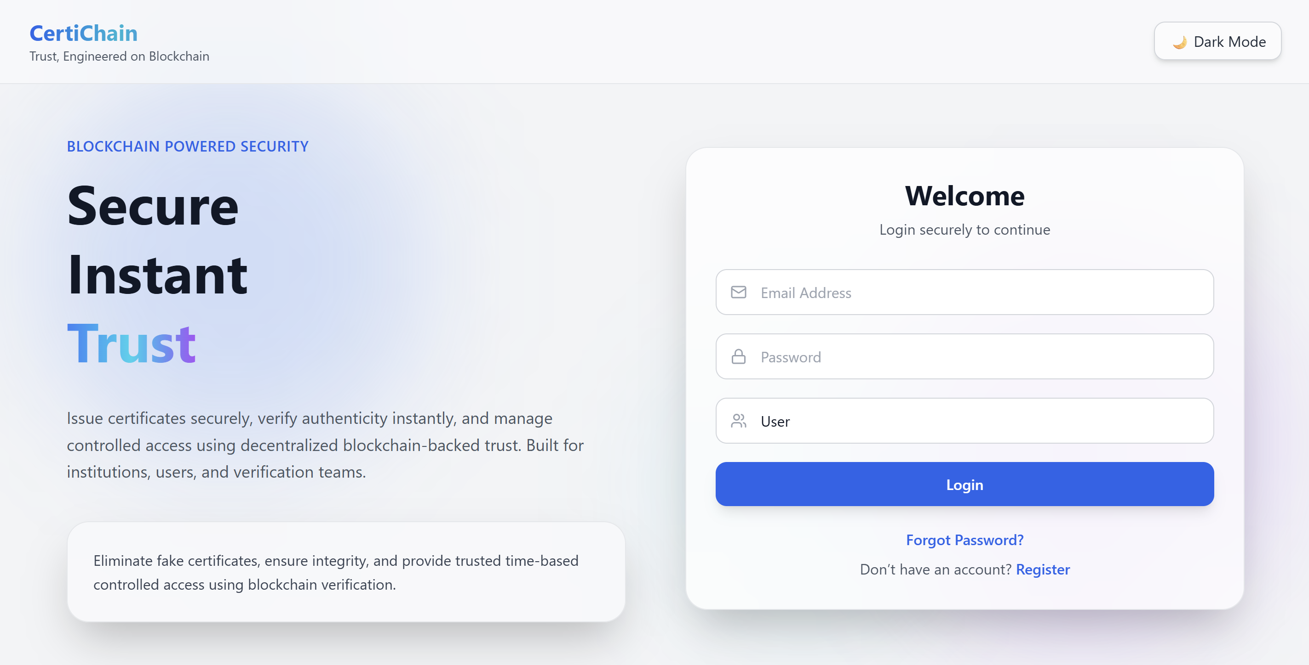
Screenshots

Slide 11
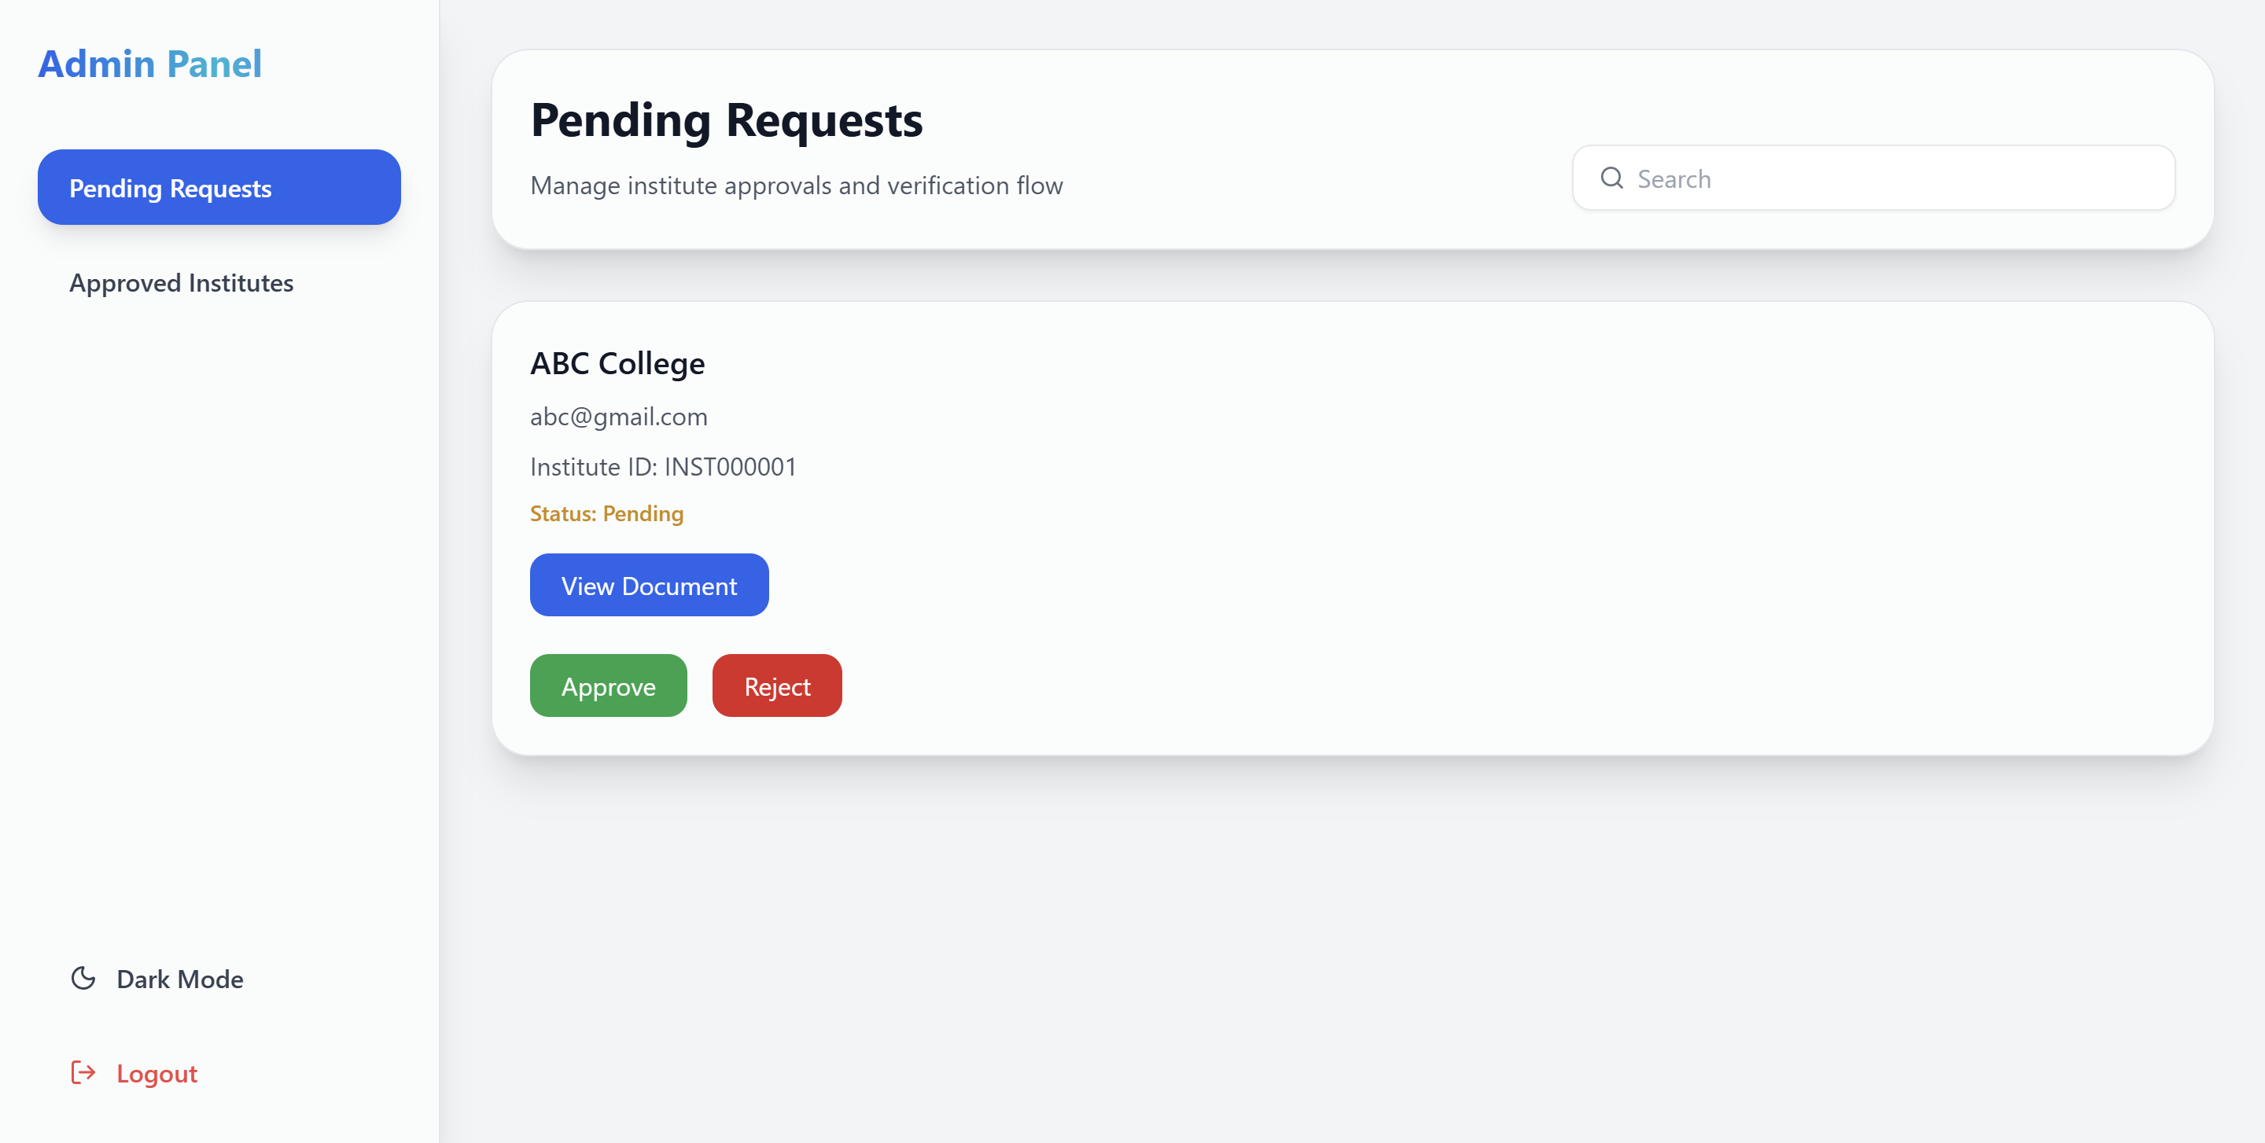
Screenshots

Slide 12
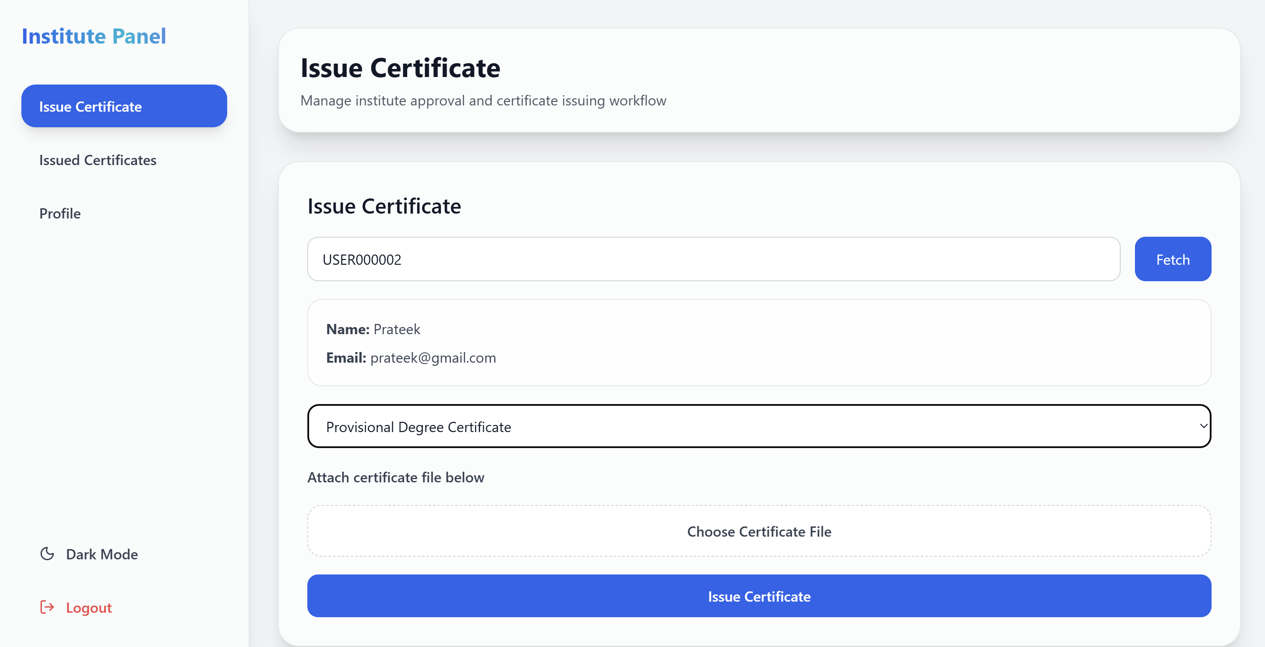
Screenshots

Slide 13
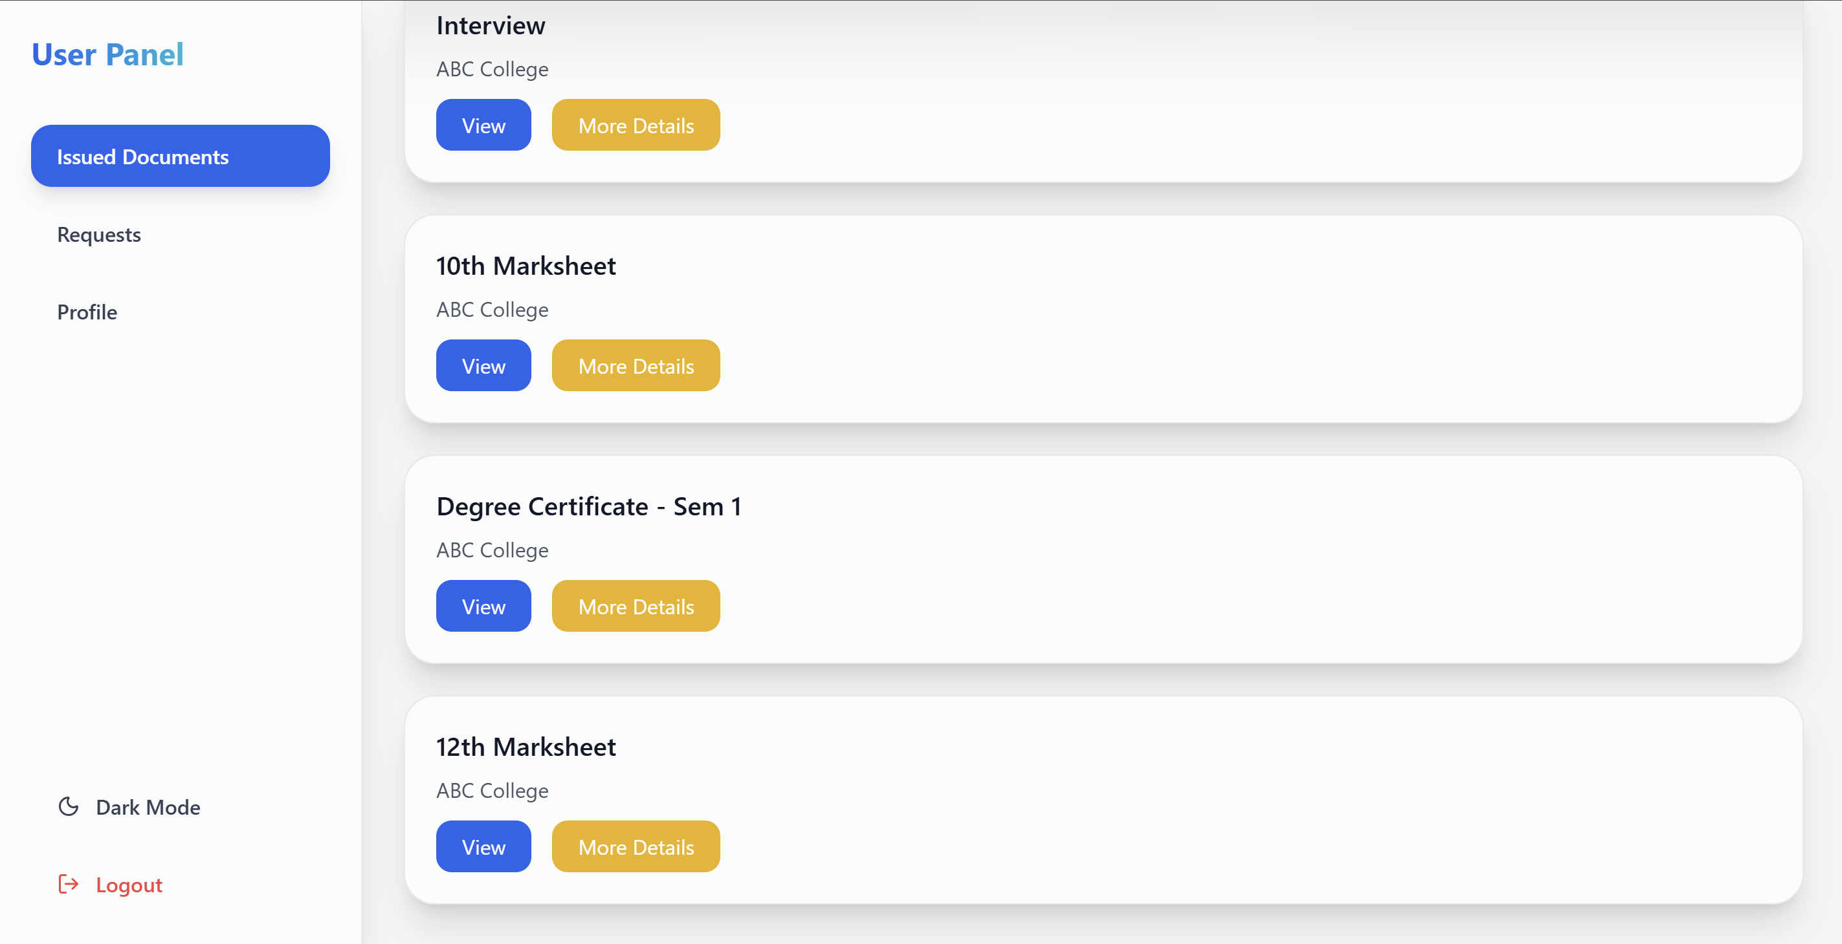
Screenshots

Slide 14
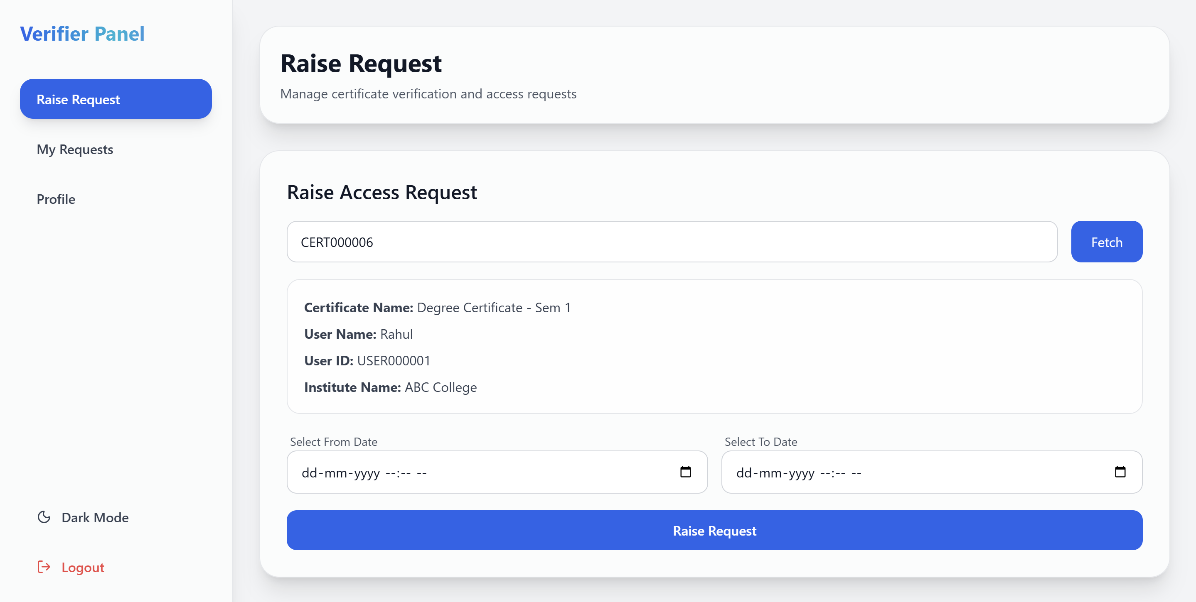
Screenshots

Slide 15
Conclusion
Developed a secure and decentralized certificate verification system using Blockchain and IPFS.
Successfully prevented certificate tampering through blockchain-based integrity verification.
Implemented secure role-based access for Admin, Institute, User, and Verifier modules.
Achieved reliable certificate issuance, storage, and verification workflow.
Improved transparency, authenticity, and security in digital certificate management.
Successfully integrated frontend, backend, blockchain, and IPFS technologies into a complete working system.

Slide 16
Future Enhancements
QR-code based certificate verification.
Mobile application support for easier access.
Public certificate verification portal.
Real-time notification and email alert system.
Cloud deployment with scalability improvements.
Advanced analytics and reporting dashboard.

Slide 17
References
[1] M. Tmeizeh et al., “Blockchain-based Data Preservation Framework,” Springer, 2024.
[2] Y. Wang et al., “Storage Optimization Techniques in Blockchain,” MDPI, 2024.
[3] P. Chinnasamy et al., “Blockchain-based Educational Document Management,” Scientific Reports, 2025.
[4] O. Hammoud et al., “Blockchain-based File Storage Systems,” Frontiers Blockchain, 2025.
[5] M. Islam et al., “Blockchain Log Integrity System,” arXiv, 2025.
[6] K. Choudhary et al., “Immutable Cloud Storage using Blockchain,” IJRCS, 2025.
[7] S. Kumar et al., “Blockchain and IPFS Storage Comparison,” IJRMEET, 2025.
[8] C. Antony et al., “Document Forgery Detection using Blockchain,” IJERT, 2024.
[9] S. Ma and Y. Zhang, “Blockchain + IPFS Healthcare Data Security,” Scientific Reports, 2024.
[10] T. Nododile et al., “Hybrid Blockchain-IPFS Storage System,” arXiv, 2025.

Slide 18
Details of Publication Status
Publication Type | Publication Details
International Conference | C T Ullas, “Blockchain-Based Certificate Verification and File Integrity System Using IPFS and Ethereum,” Proceedings of the International Conference on Electrical, Electronics, and Computer Science with Advance Power Technologies – A Future Trends (ICE2CPT 2026), organized by COER University in collaboration with NIT Jamshedpur, Roorkee, Haridwar, Uttarakhand, India, Nov. 19–21, 2026.

